Slide 1

Safest Solutions Green Group
Fresh Produce

Slide 2
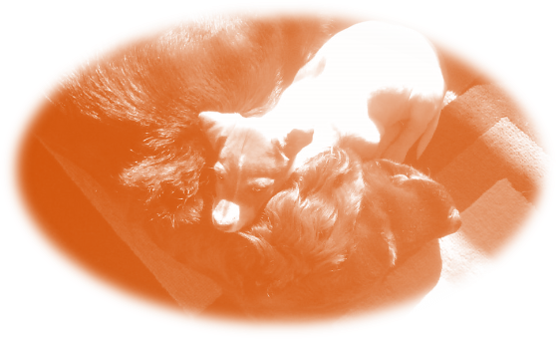
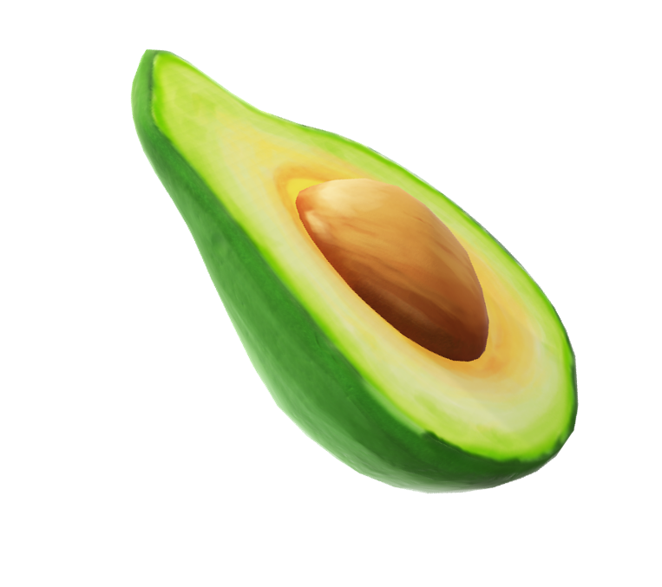
Never give a Dog …
Alcohol
Avocado
Chocolate
Cat food
Tea, Coffee
Cooked Bones

Slide 3
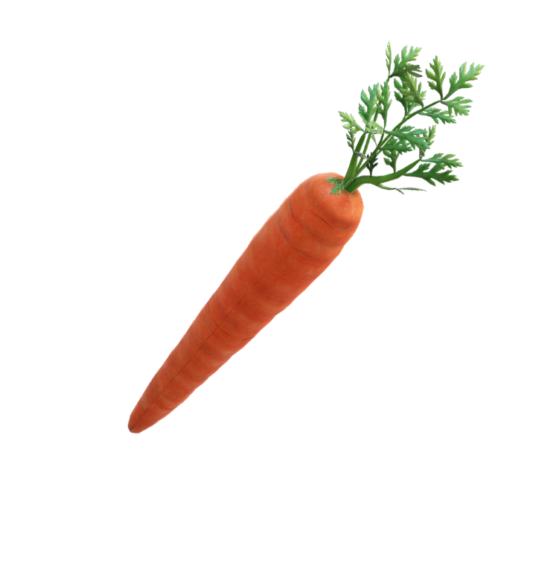
Appropriate for Dogs …
White Rice
Chicken
Fish
Peanut Butter
Plain Popcorn
Carrots

Slide 4
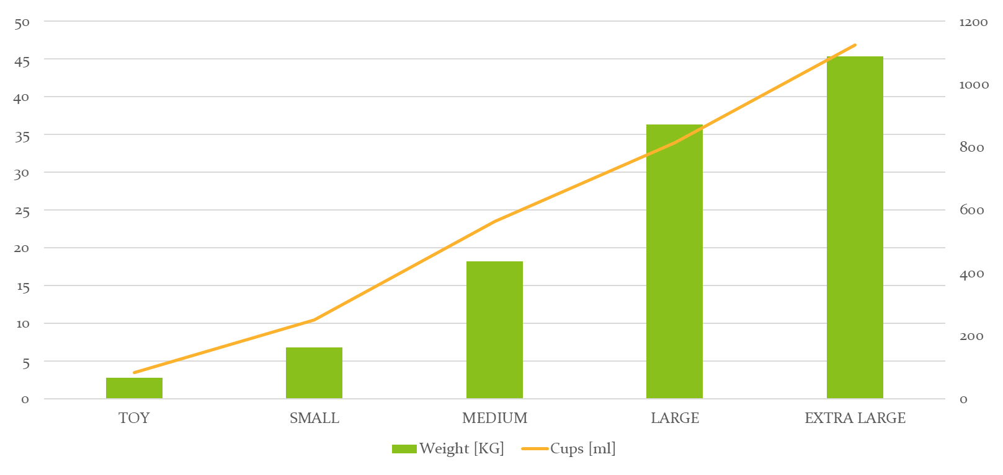
Safest Solutions Green Food Chart

Slide 5

Breed – Exercise Comparison
Small breed
Medium Breed
Large and Extra Large Breed
Class | Exercise | Mental
Small 1 | 30 min | 30
Medium 2 | 60 min | 60
Large 3 | 120 min | 90

Slide 6
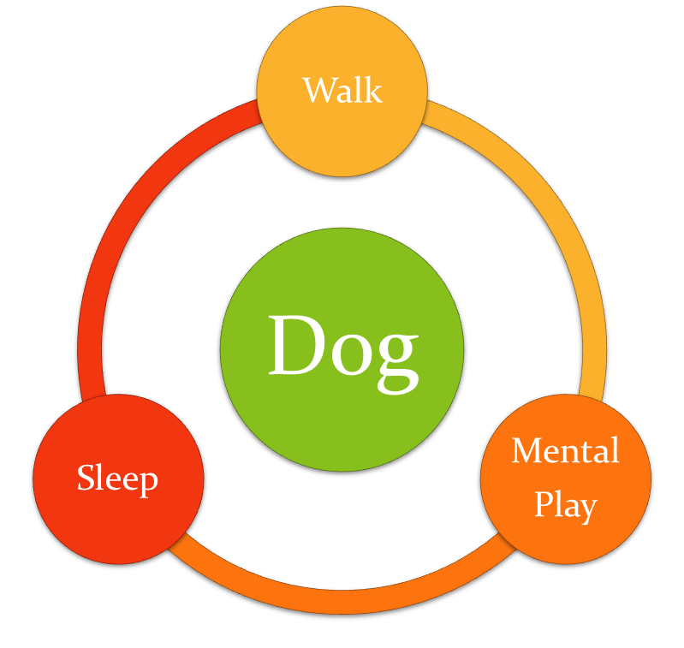
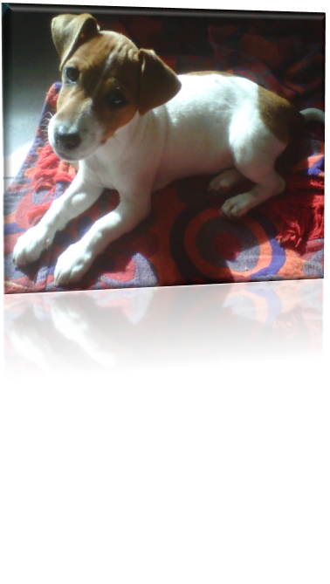
What Dogs Need
Walking 2 to 3 times per day
Mental as well as Physical Play
Sleep

